Slide 1



Ai for Everyone
Ranjith Kumar Cheela
14 + IT experience| PG in IIIT Bangalore
Tech stack Ai, ML, DS, RPA

Slide 2

Key Take Aways
In this session we will look at the Basics of Data, understanding data engineering .
We further talk about Machine learning techniques and classify the algorithms pointed by a problems.
Why and how we can use this actual tech stack and what are their applications.
What are the different layers of the AI and how actually LLM works.

Slide 3


Technology Classification
Data Engineering
Data Analysis
Data Visualization
Artificial intelligence

Slide 4
Data engineering
When we talk about data engineering, its all about handling and managing of a data, let us try to understand this with an example
Let’s talk about shopping spree, when JPMC taken over FRB case, both are of from the same business, however the tech stack might be different how Data Engineering help here for the optimization and cost?
How the data engineering help in data flow for all the upstream and downstream applications ?

Slide 5
EDA (exploratory Data analysis)
To simplify this, its all about how we analyze data correctly, or what is the correct data?
To identify the right continuous and discreet variables
Identify outliers
Identify null values and their importance and how we handle them?

Slide 6

Data Analysis And visualization
Post Data engineering if the pipeline is fed to a model, the data being analyzed as per the requirements.
Here in this example, we analyze the data of the same banking products, their trends and profits and how the common products were doing across the demographics?
What are different types of data visualization tools like demographic visualization, trend line charts, histograms, bar graphs and hear maps etc;

Slide 7
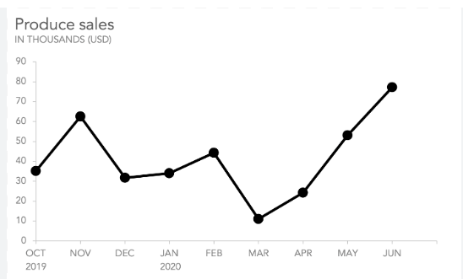
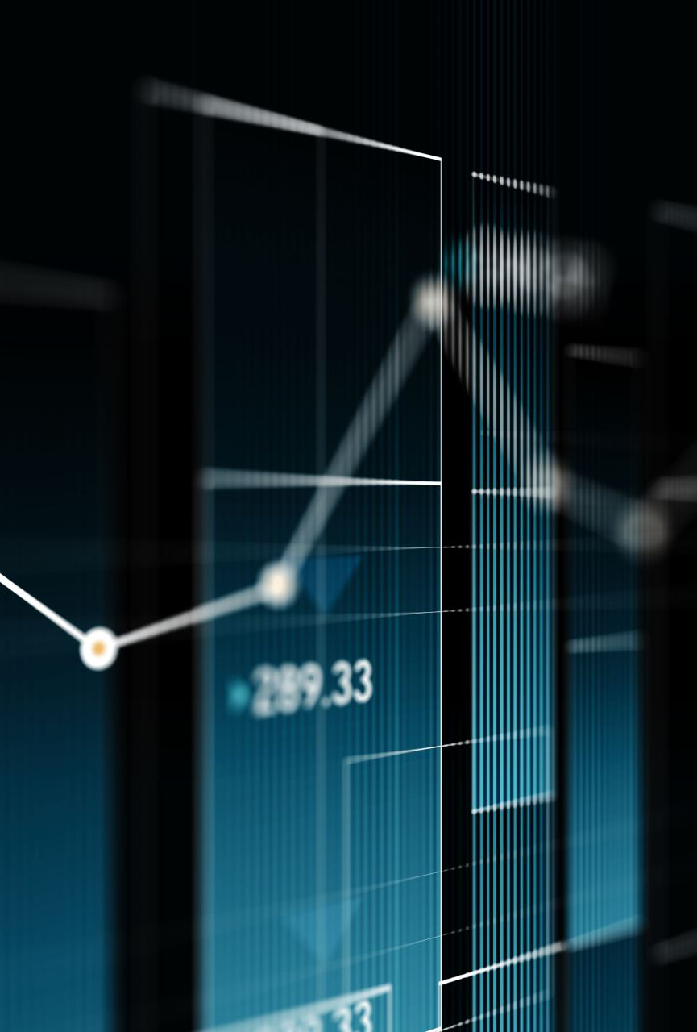
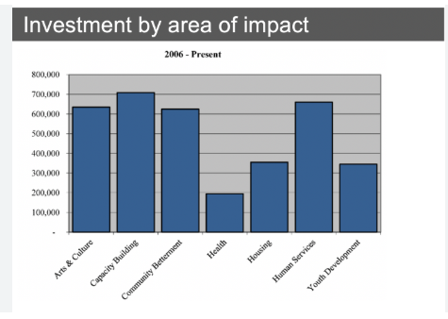
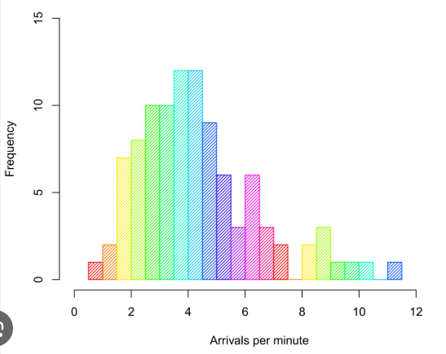
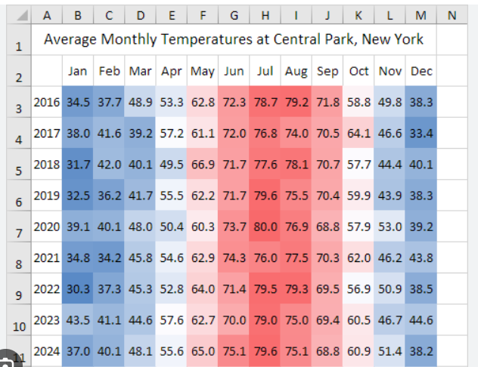
Where to use what kind of visualization
Line Graph: Helps us to analyze the trends
Bar Graph: Helps us to analyze the categories and trends together
Histograms: Helps us to analyzing continuous data and statical analysis
Heat maps : Helps us to analyze multi dimensional data ex: sales of products in and across different demographics

Slide 8
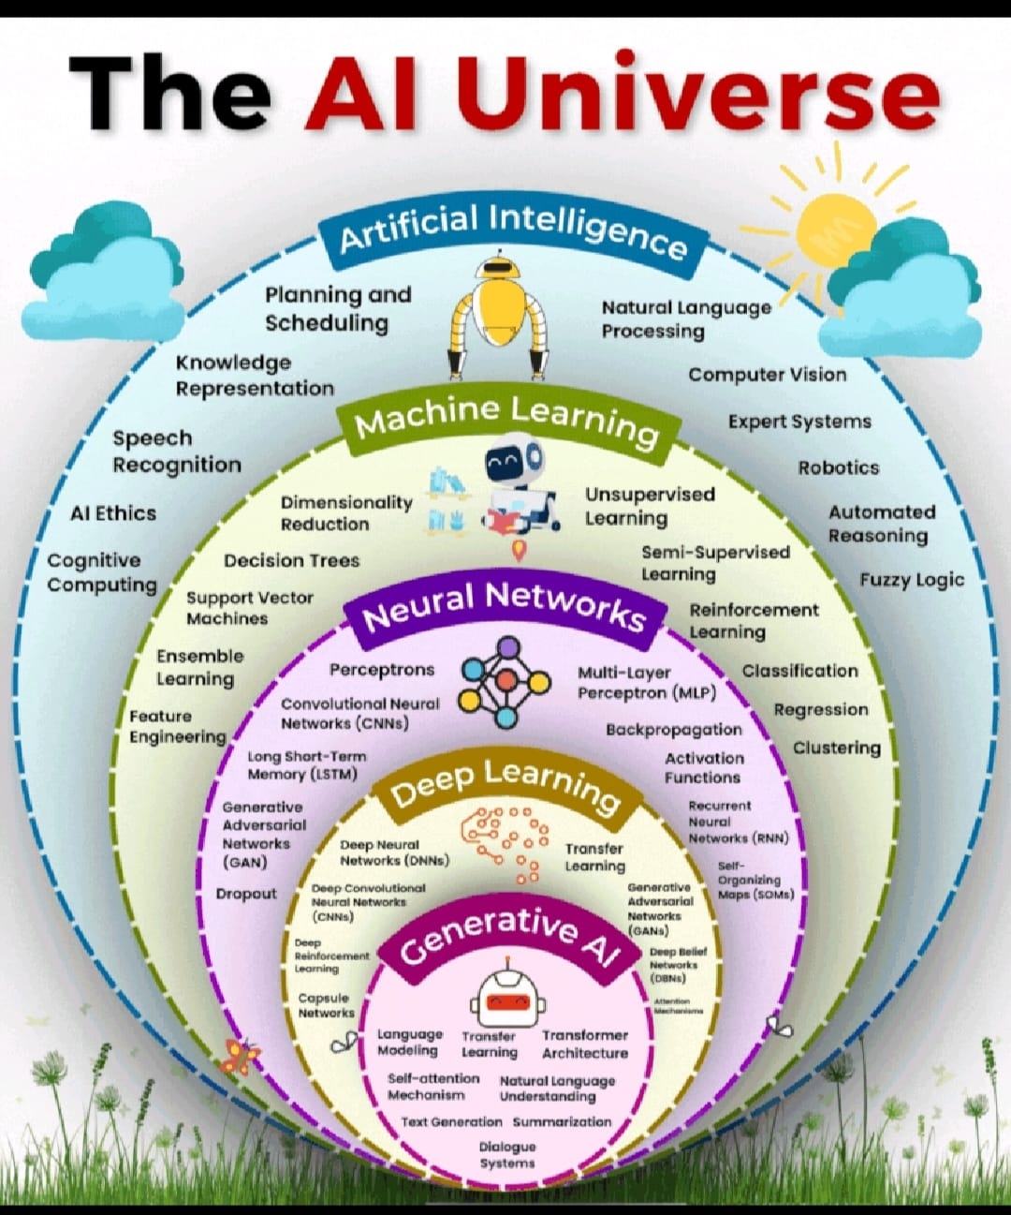
THE AI universe
AI is a combo of multiple tech stack.
Machine learning is key of many and important Arsenal to master AI.
Neural Networks and Deep learning has the GANs and CNNs as the core of the tech.
Finally, Gen AI is the Reinforcement hero who learns everything based on the past data and trends.

Slide 9
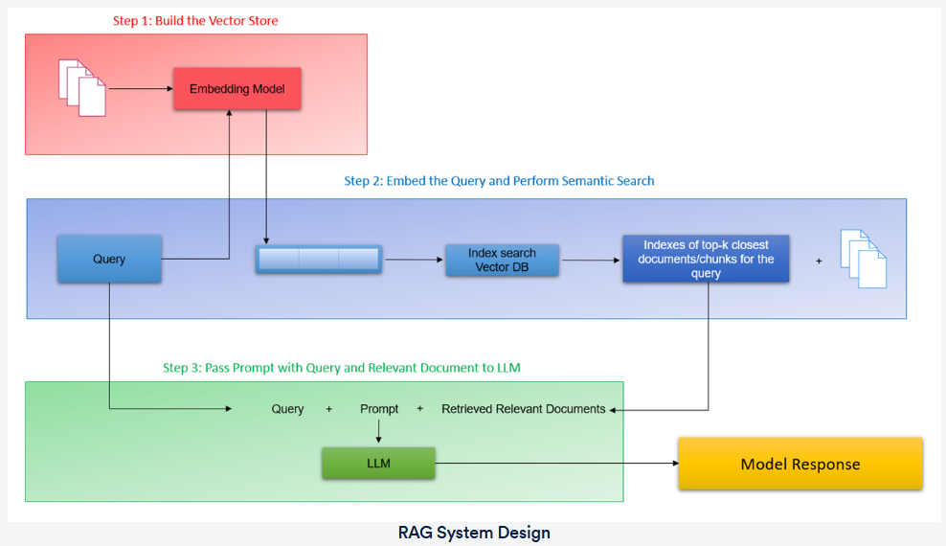
RAG Design
Retrieval Augmented Geenration (RAG)
A technique that enhances the capabilities of language models by incorporating external knowledge sources during the generation process
Embedding model converts prompt in to Vectors
Vector Data set is the key where the documents/data is stored in Vector format
The output is fed to the LLM and responds back to the User

Slide 10

Prompt Engineering
Want to understand what is the prompt and correct prompt?
Why we need to engineer the Prompt and what are the correct techniques to do so?
Explicitly state the task to be performed to get the required output
Role of the language model for performing the task
Context in which the task must be done
Guidelines on how to perform the task
The desired output format of the ideal response

Slide 11
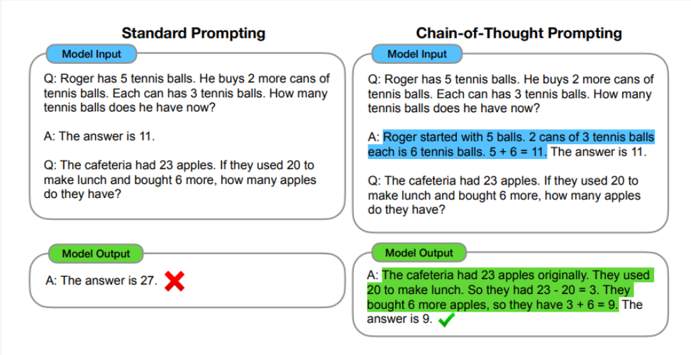
Prompting techniques
Few Shot Prompting
Chain of thought prompting
Few shot prompting is a technique, to train the LLM based on examples rather than providing large data set with labeled examples

Slide 12
Ai for Everyone Its not for the Tech wizards, Its for every Future Human
Q&A

